Slide 1
Mission 11 Remix
Create your own project from Mission 11

Slide 2

Warm-up
Mission 11 introduced a way to use the accelerometer. You used it for creating a spirit level.
What are some digital devices that might have an accelerometer in it?

Slide 3

Time for a project remix!
A remix can be:
A new program created by adding new code to a program you already created
You can combine parts of two or more programs in a remix
Use a similar idea in a different way

Slide 4
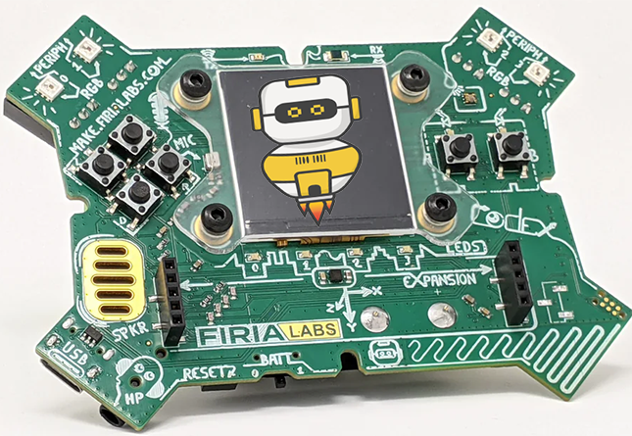
Project Remix
Creating a remix will let you:
Improve your skills and practice the concepts from the mission
Be creative
Remember code from earlier programs and missions
Work with other students
Design an original program and write the code all on your own

Slide 5
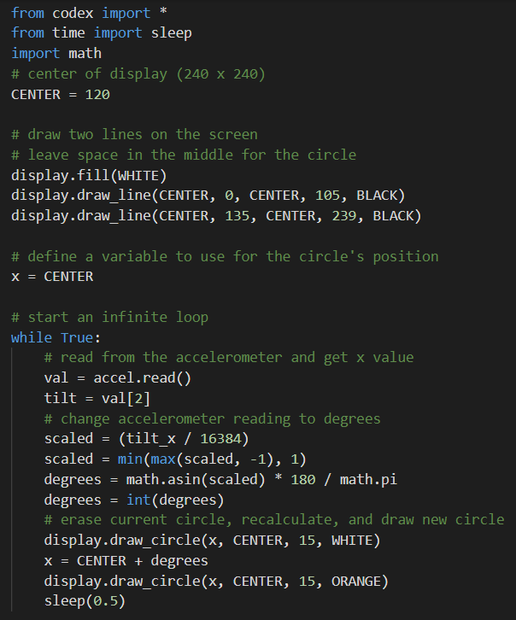
Step #1
Review the mission
Open your project from
Mission 11
  What does the program do?
  What skills were used or concepts learned?
DO THIS:
Fill out the information in the Mission 11 Remix Log for Step 1

Slide 6
Step #2
Brainstorm ideas
Read through remix suggestions from your teacher
Seven suggestions are on the next 4 slides. You can use any of these ideas or come up with your own.

Slide 7
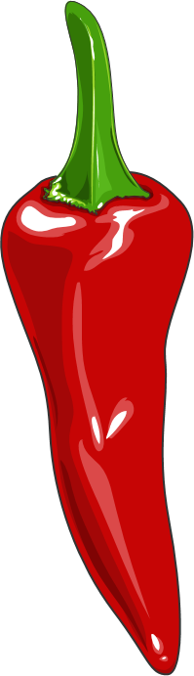
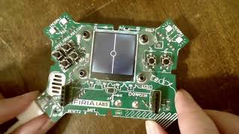
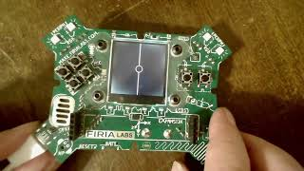
Step #2 Remix Ideas
Mild-1A
Start with the original code. Create at least one function and call it in the program. Suggestions:
a function that sets up the screen and lines
a function that scales the raw data to degrees
Mild-1B
Add an introduction and wait to start the game. Add a way to exit the program using in if statement, and an ending message. The intro can be a function, but it doesn’t have to be.

Slide 8
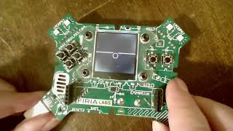
Step #2 Remix Ideas
Mild-1C
Change the horizontal bubble to a vertical bubble
(use y instead of x).

Slide 9
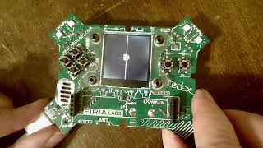
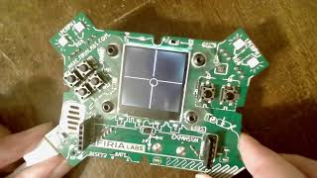
Step #2 Remix Ideas
Medium-2A
Change the circle to a filled-in circle when CodeX is level. This remix can include an intro and ending.
Medium-2B
Change the spirit level to check both the horizontal and vertical positions
(use both x and y).

Slide 10
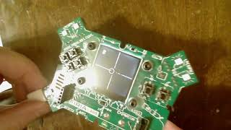
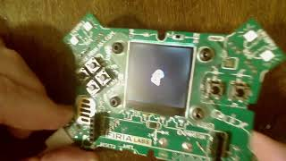
Step #2
Spicy-3A
Make the spirit level into a game. Award a point for going close to the edge but not touching the edge. Get four points to win the game. Touch an edge and the game ends.
Spicy-3B
Change the spirit level to a spirograph. Instead of erasing the circle, let it continue to draw on the screen. Choose a random color after every 20 circles.

Slide 11
Step #2
Brainstorm ideas
Read through remix suggestions from your teacher (previous slides)
Use the suggestions as presented, or combine some of the options for your own mild, medium, or spicy project
Use your creativity to come up with your own idea for a project
Decide with your partner what project you will do
DO THIS:
Fill out the information in the Mission 11 Remix Log for Step #2

Slide 12
Step #3
Make a plan
What variables will you need? What will you use them for?
What functions will you create for the program?
Do you need a list? If so, what information will it store?
What buttons will you program, and what will each button do?
DO THIS:
Fill out the information in the Mission 11 Remix Log for Step #3

Slide 13

Step #4
Code your project
IMPORTANT: In CodeSpace, go to the sandbox
Start with a new file and give it a descriptive name (Remix11)
You can leave any program open, including Spirit Level, and use it as a guide
Import your modules
Create functions as you go, or when you see a need
Write your code, testing frequently

Slide 14
Step #4
Stop and test frequently!
Don’t try to write all the code at one time
Think about the steps:
  Just get one thing to work, then move on
  Step by step!
Mistakes happen, so find them early
Type just a few lines of code and then run the program
If there is an error, fix it before continuing
Use the debugger and your other programs for help

Slide 15
Step #5
Documentation!
Make sure your code is readable by adding blank lines
Add comments to sections of your code that explain what they do

Slide 16
Step #5
Get feedback
Show your code to other students.
What do they think? Have them fill out the feedback form on your Mission 11 Remix Log.
The Mission Log has space for two people to give feedback. The feedback can come from two peers or one peer and yourself.
Modify your code to make your project even better

Slide 17

And now you have your own remix!
Congratulations!
By completing this remix you have:
learned more about programming
practiced the skills and concepts from the missions
been thinking! And problem solving and much more!

Slide 18
Mission Reflection
Wow! Great job!
Share your project with your friends!
Run projects from other students
Complete your Mission 11 Remix Log
Don’t forget to clear your CodeX by running your Clear program

